Slide 1



The Flighter
Goran Jawdat
Gerald Low
Ashley See

Slide 2
Problem
Everyone has ideal holiday locations
Everyone wants the cheapest flight deals
No one has time to query skyscanner every day

Slide 3
Solution
Using Skyscanner API
01
Subscription Service
02
Automated Querying Every Day
03
Notification Via Email
04

Slide 4
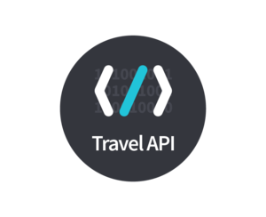




Demo

Slide 5
Our Product
Works like camelcamelcamel for flights
Register with home location and ideal destinations
Daily calculation based on moving averages in the background
Trigger events lead to emails with straightforward links

Slide 6
¡Muchas Gracias!

